Slide 1
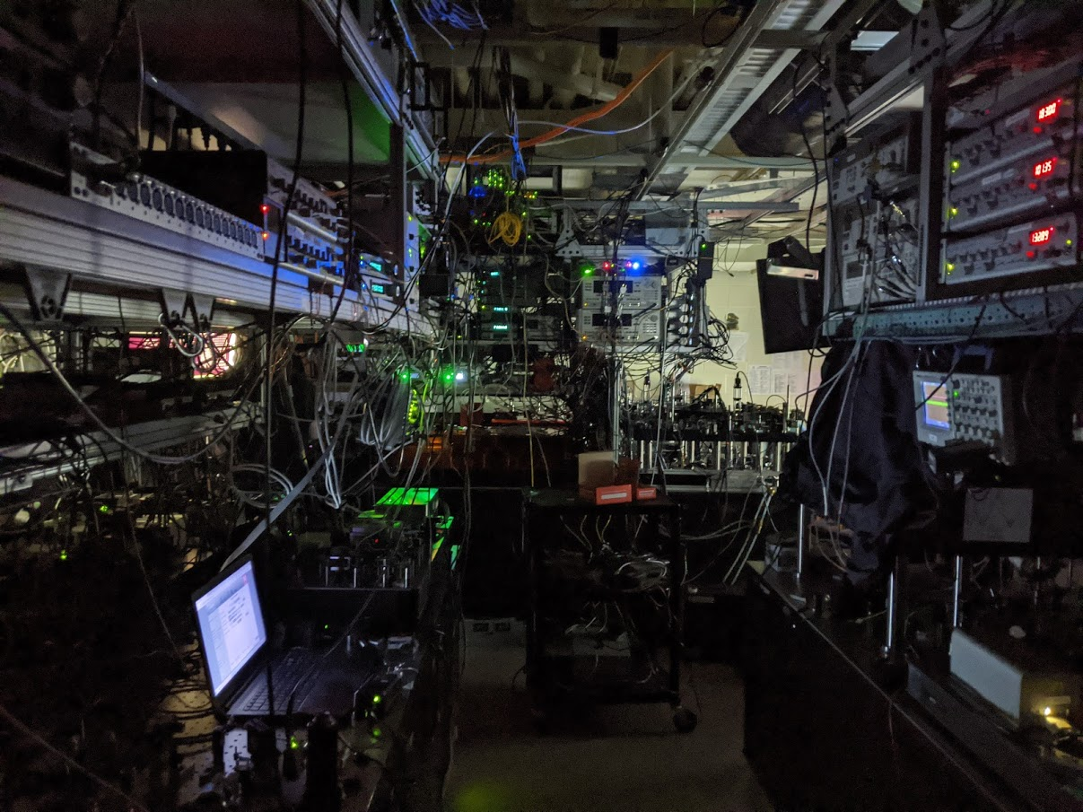










T. M. Graham*
Yunheung Song*
J. Scott
C. Poole
L. Phuttitarn
K. Jooya
P. Eichler
X. Jiang
A. Marra
B. Grinkemeyer
M. Kwon
M. Ebert
J. Cherek
M. T. Lichtman
M. Gillette
D. Bowman
J. Gilbert
T. Balance
C. Campbell
E. D. Dahl
T. Noel
APTQS 2022, April 22
O. Crawford
N. S. Blunt
B. Rogers
Mark Saffman
Demonstration of multi-qubit algorithms
on a programmable neutral-atom quantum computer
Nature 604, 457 (2022)
wqi.wisc.edu

Slide 2

Advantage of neutral-atom platform: isolation & control → scalability
Laser cooled large number of atoms trapped by light in vacuum.
Superb quantum memory with coherence from seconds to minutes.
Selective control using laser pulses.
Excitation of Rydberg state provides strong interactions and fast multi-qubit logic operations.
strong interaction
Rydberg
atoms
Laser pulse
on/off ratio 10¹²
Neutral atoms trapped by light
Quantum properties maintained for seconds to minutes.
Neutral-atom experiments at: UW, Harvard, Caltech, UChicago, Boulder, Princeton, Penn State, KAIST, Wuhan, IMS, NUS, Institut d'Optique etc. + ColdQuanta, QuEra, Atom Computing, PASQAL

Slide 3
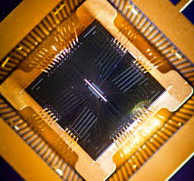
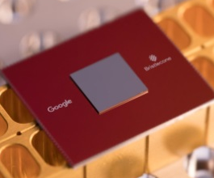

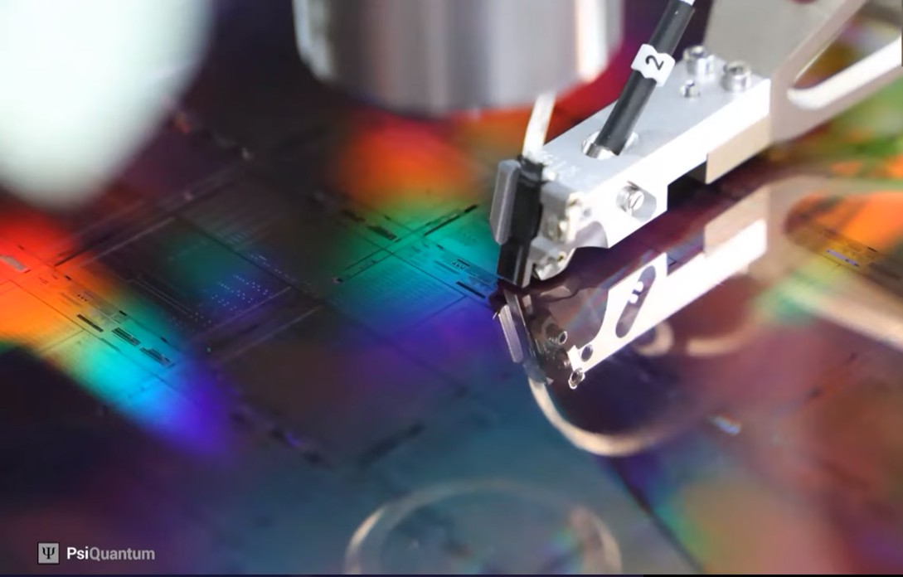
Quantum computing platforms with programmable processors
trapped ions
superconductors
neutral atoms
Nature 534, 516 (2016), Nature 536, 63 (2016)
Nature 460, 240 (2009)
Nature 574, 505 (2019)
photons
quantum dots
still no demonstration of quantum algorithms
Nat. Photonics 7, 223 (2013)
Nature 555, 633 (2018)

Slide 4
Recent advances in neutral-atom platform
Blue-detuned, magic traps for long coherence
Deterministic array preparation by atom rearrangement
Microwave + Stark addressing – Arbitrary single-qubit gate (F > 99%)
Rydberg-mediated two-qubit gate – F_{CZ} > 97% (global), but F_{CZ} < 90% (local)
T₂ ~ 10 s, Y. Wang et al., Science 352, 1562 (2016)
T₂* ~ 1 s, R. Guo et al., Phys. Rev. Lett. 124, 153201 (2020)
H. Kim et al., Nat. Commun. 7, 13317 (2016)
D. Barredo et al., Science 354, 1021 (2016)
M. Endres, et al., Science 354, 1024 (2016)
T. Xia et al., Phys. Rev. Lett. 114, 100503 (2015)
Y. Wang et al., Science 352, 1562 (2016)
H. Levine et al., Phys. Rev. Lett. 123, 170503 (2019)
T. Graham el al., Phys. Rev. Lett. 123, 230501 (2019)
Combining all the advances, as well as
improving Rydberg CZ gate with local addressing

Slide 5
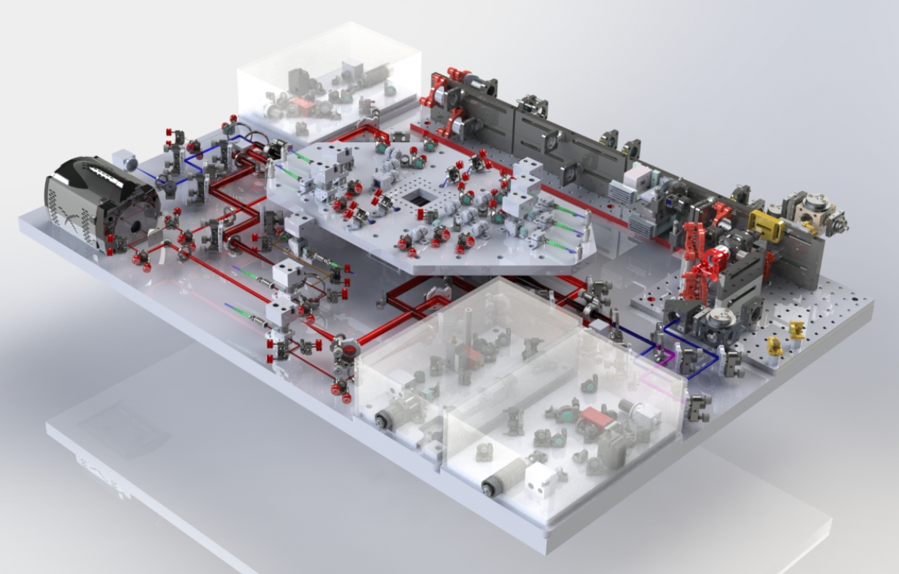
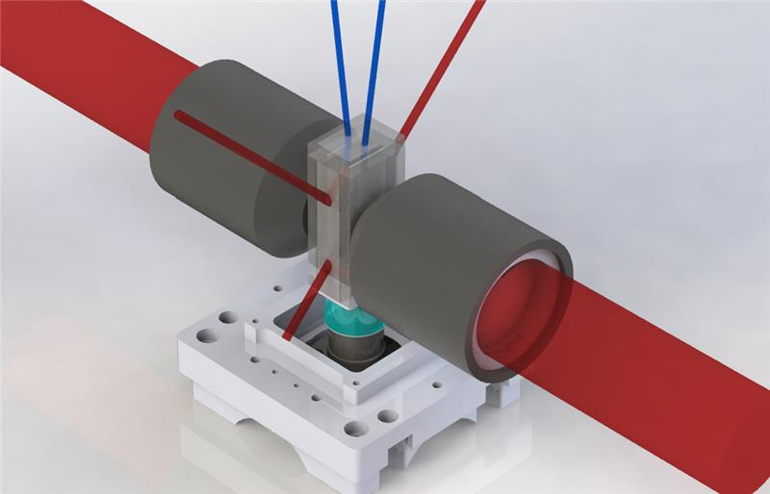
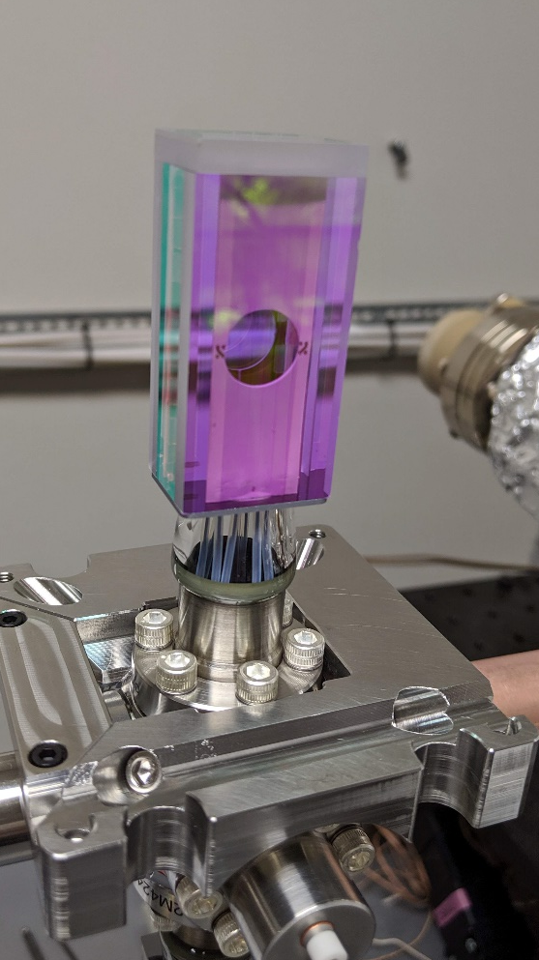
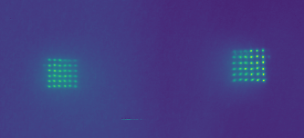

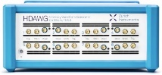
New machine: Quantum Processing Unit
UHV cell with
electrodes
QPU
459 nm
Rydberg
scanner
cooling light
Cooling & imaging
optics
camera
dynamic
line array
NA 0.7
825 nm blue traps
Control system, Lasers & electronics upgrades
Atom
rearranger
1040 nm
Rydberg
scanner
Deterministic array : blue-detuned traps + red-detuned rearranger
Arbitrary single qubit gate by global and individual atom addressing.
CZ gate by dual-atom addressing.
Running arbitrary quantum circuits with universal gate set.

Slide 6
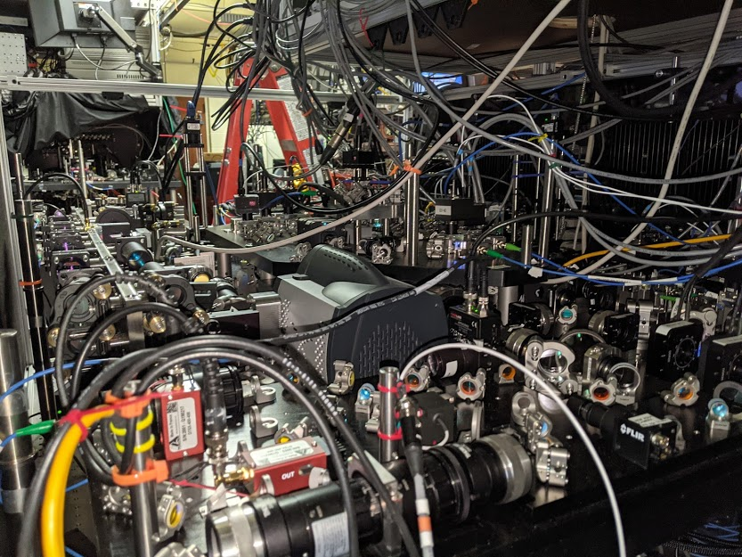

Slide 7
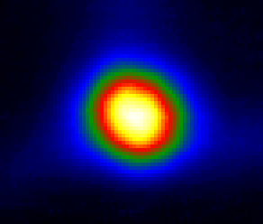
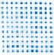
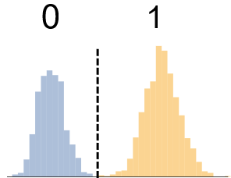
Operational Sequence
Qubit Register Preparation
Calculation Cycle
Cold
Atoms
Single Atom
Array
Filled
Array
State
Initialization
Quantum
Circuit
Measure
Results
1
0
f=4
|1>
Cesium
f=3
|0>
Camera
Camera
Camera
Optical Pumping
895 nm laser
Gates
1Q, 2Q
459 nm, 1040 nm lasers, μwaves
Laser cooling
852,895 nm lasers
Array
825 nm lasers,
Deep cooling
Rearrange-ment
1064 nm
laser
852 nm lasers
Controlling the Mechanics
Controlling the Quantum

Slide 8

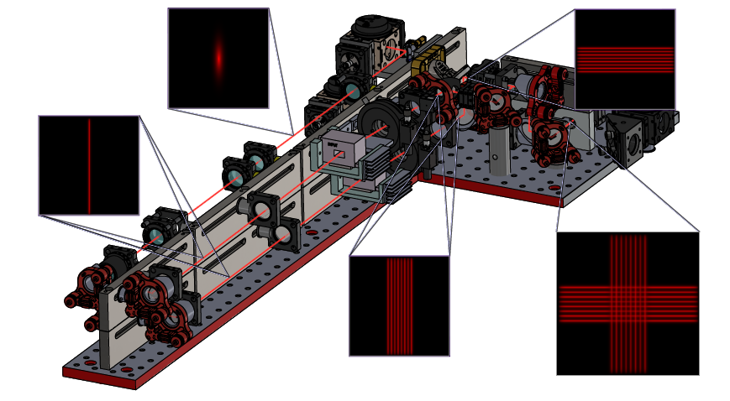
Scalable blue-detuned traps: dynamic line array
Gaussian line array
Diffractive element for line shape
Multi-frequency AOD diffraction
suppressed Talbot effect
1 to 21×21 = 441 sites

Slide 9
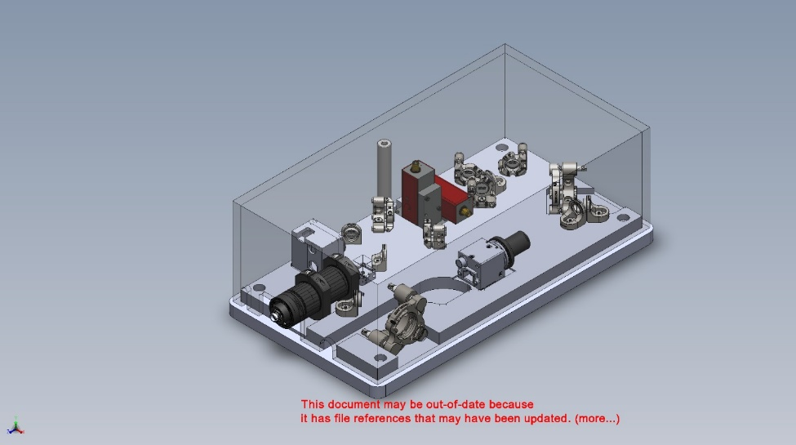

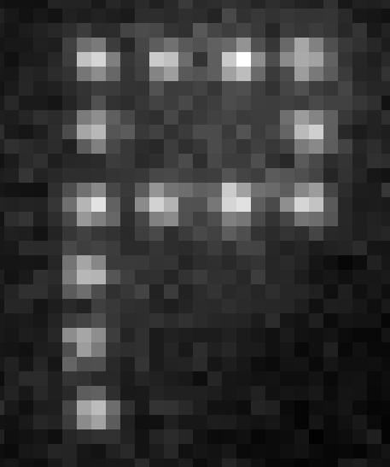
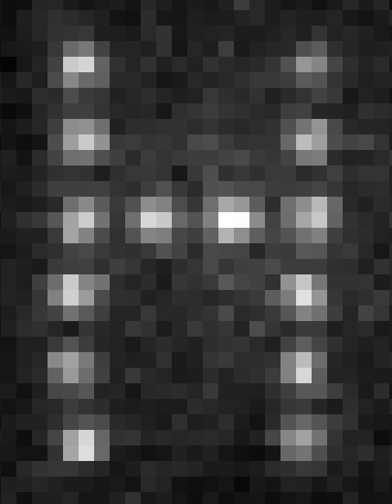
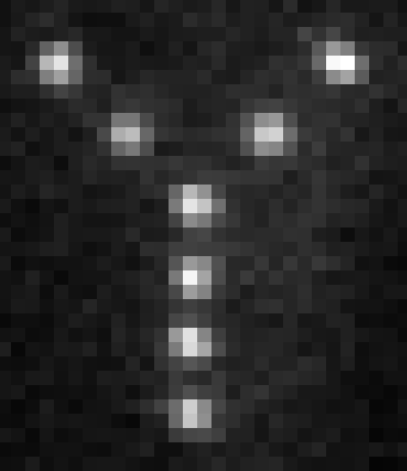
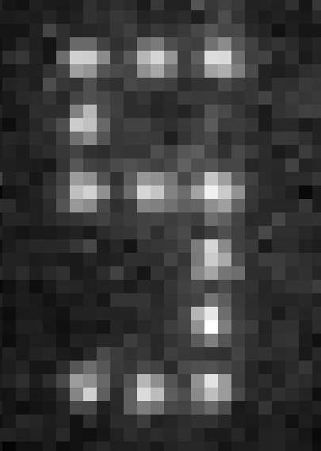

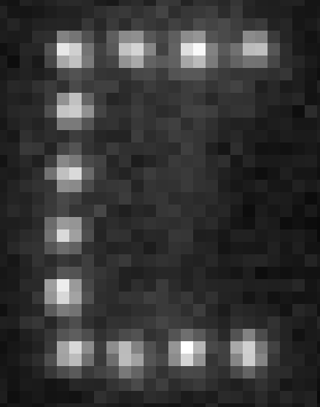
Atom rearrangement for deterministic loading
The array is deterministically filled using 2D AOD rearranger from stochastically loaded single atoms.
1064 nm
1064-nm
tweezer
Gaussian line array
Gaussian line array
AOD-X
AOD-Y
Rearranger module
Rearranger monitor
original work: Browaeys group (2016)
also see Ahn group (SLM, 2016),
Lukin group (1D AOD, 2016), …
3 μm

Slide 10
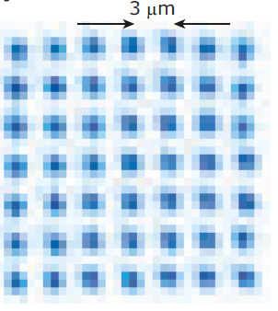
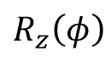
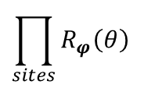
Qubit preparation and control
Cs
Encode in Cs clock states:
f=4
|1>
9.2 GHz
f=3
|0>
m_{f}=0
Optical pumping with > 99% fidelity
Universal gate set:
Global
microwaves
$$\prod_{sites}{R_{φ}\left(θ\right)}$$
Rydberg blockade
Trap depth = 300 μK
Temperature = 5 μK
Lifetime ~ 10 s
T₁ ~ 4 s
T₂ ~ 1 s
T₂* = 3.5 ms
Angle 𝝋 in x-y plane
from μwave phase
i,j site indices
(or more)
Single-site
AC Stark shift
$$R_{z}\left(φ\right)$$
Native multi-qubit gates are also possible: C_{k}NOT, CNOT_{k}
(related experiments at Harvard and Strathclyde)

Slide 11
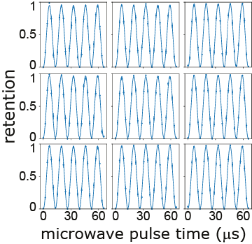
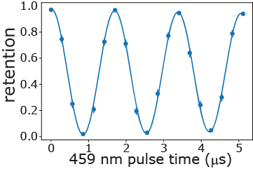
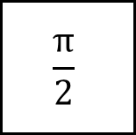
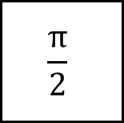
Single-qubit gate performance
Global microwave Rabi oscillation
Local Stark shift by 459 nm laser
μwave
459 pulse
μwave
$$\frac{π}{2}$$
$$\frac{π}{2}$$
t
T_{π} = 6.5 μs >> T₂* = 3.5 ms
f_{stark} × τ_{decay} = 32

Slide 12
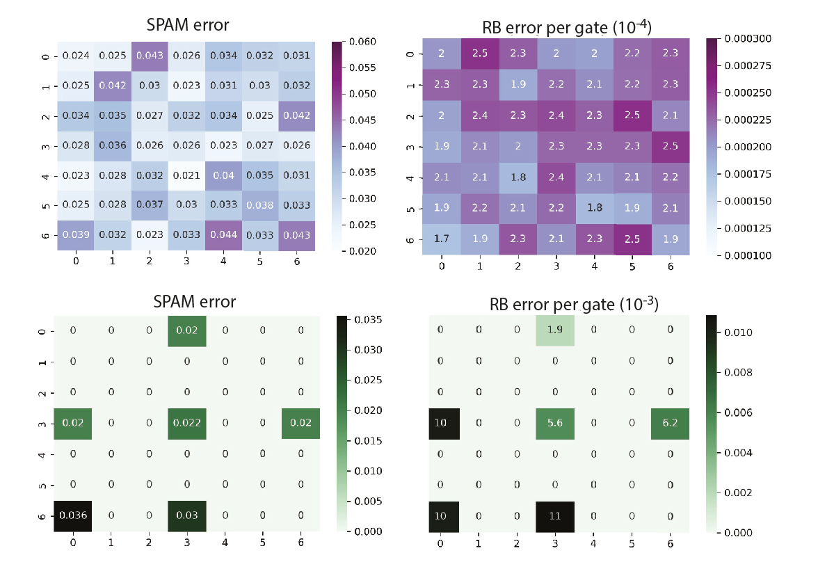
Single-qubit gate performance – randomized benchmarking
Averaged performance over all sites
Global
gates
SPAM error : 2.5%
F_{global} = 99.978%
F_{local} = 99.25%
Could be further improved by better cooling, more laser power and detuning, beam shaping …
Local
gates
Nature 604, 457 (2022)

Slide 13
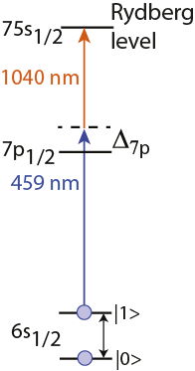
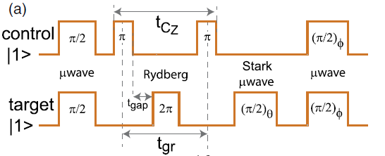
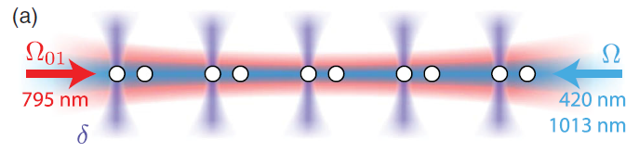
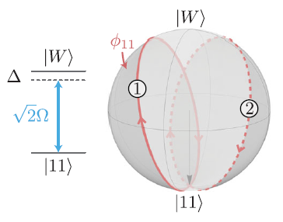
Improved two-qubit gate – Joint Illumination
Single-addressed sequential CZ gate
Global-addressed simultaneous CZ gate
0.76 GHz
H. Levine et al., PRL (2019)
T. M. Graham et al., PRL (2019)
Simultaneous CZ gate for shorter time and better coherence

Slide 14
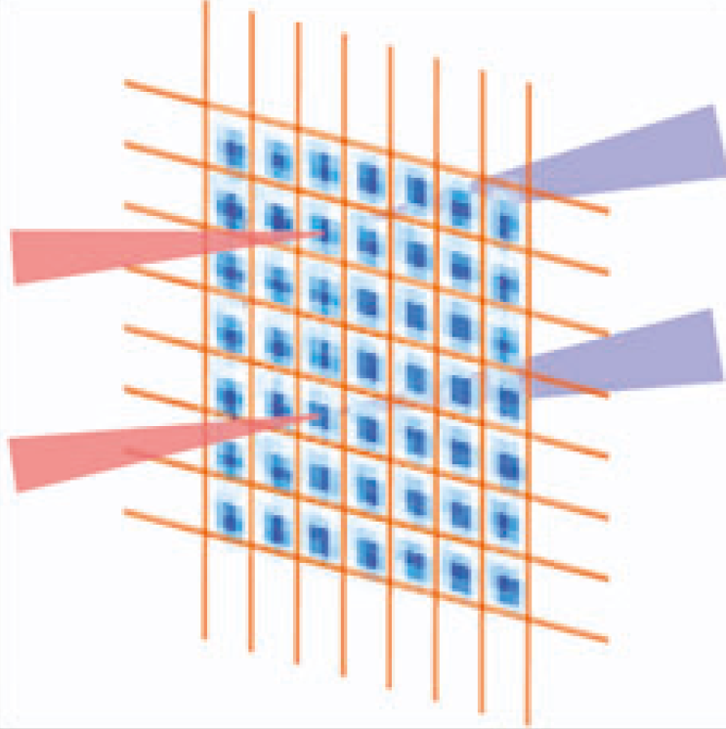
Improved two-qubit gate – Joint Illumination
Dual-addressed simultaneous CZ gate
Global-addressed simultaneous CZ gate
459 nm
1040 nm
0.76 GHz
AOD -1 order
H. Levine et al., PRL (2019)
AOD +1 order
Simultaneous CZ gate for shorter time and better coherence
Arbitrary waveform generator drives acousto-optic deflector with two tones to target two atoms.
Deflector frequency shifts are opposite for the two photons of the transition
→ site-independent Rydberg resonance

Slide 15
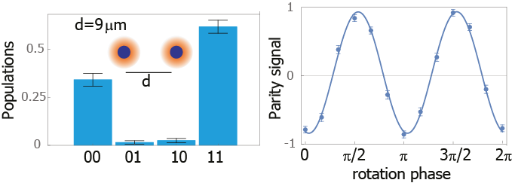
Improved two-qubit gate performance – Bell-state fidelity
Beam waist w=3 μm
d=9 μm
75s state
B_{field}=16 G
B/2π=3.0 MHz
Ω/2π=1.7 MHz
Δ=-0.25 Ω
Dual addressing of sites 9 um apart – to avoid crosstalk
Modified parameters for weak blockade.
Best Bell-state fidelity = 92.7% (raw)
= 95.5% (SPAM corrected)
Bell-state fidelity over 5 pairs = 90% (raw)
= 92.5% (SPAM corrected)
Nature 604, 457 (2022)

Slide 16
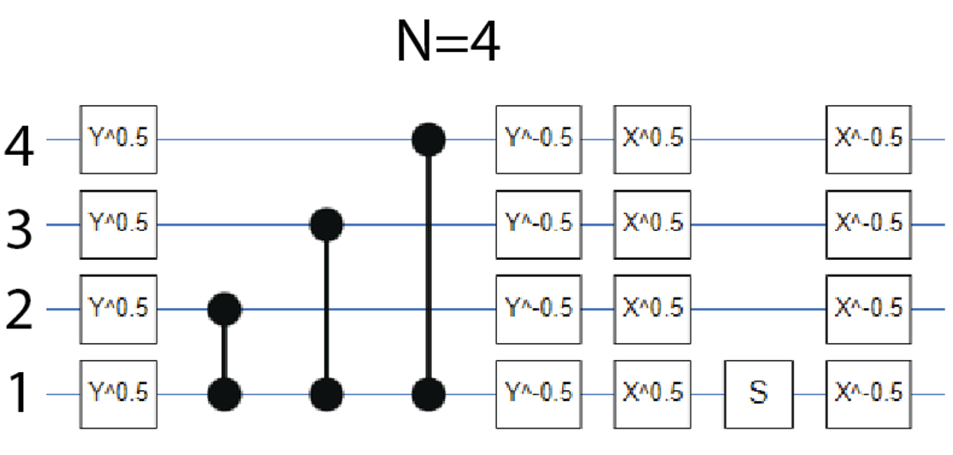
GHZ states
A good test of the computer is preparation of entangled GHZ states
Genuinely N-qubit entangled
Fragile

Slide 17
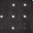
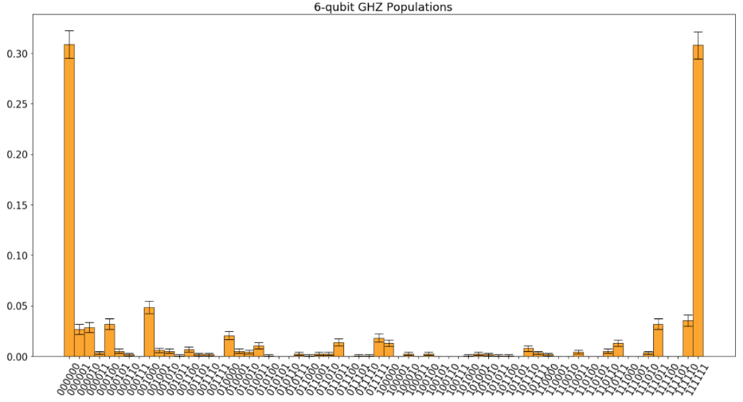
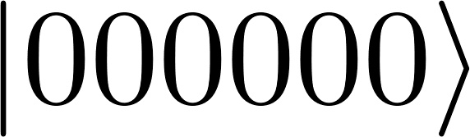
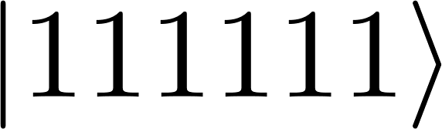
GHZ state preparation
Successful preparation up to 6 qubits
0.3
N=6
500 times improvement from g-r qubits
0
Nature 604, 457 (2022)

Slide 18
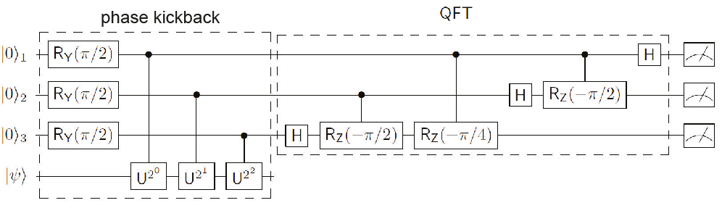
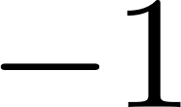
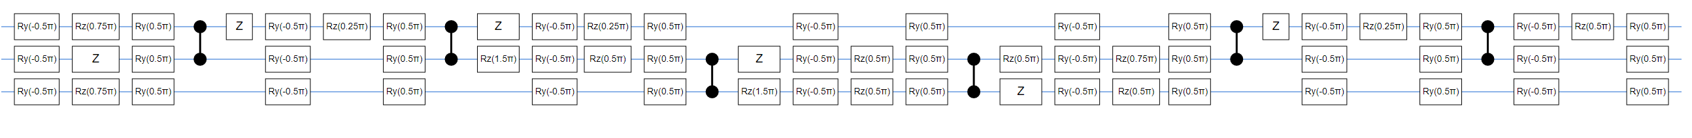
Quantum phase estimation
Quantum phase estimation is one of the most important quantum algorithms. Useful for quantum chemistry and factoring.
Test for measuring phases of 0, π/2, π, 3π/2

Slide 19
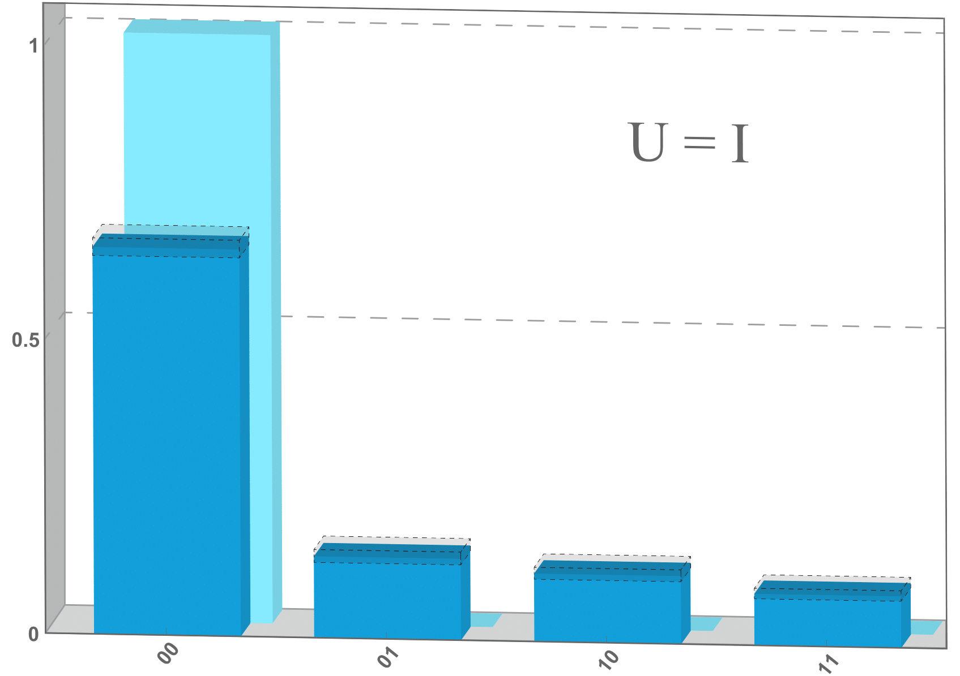
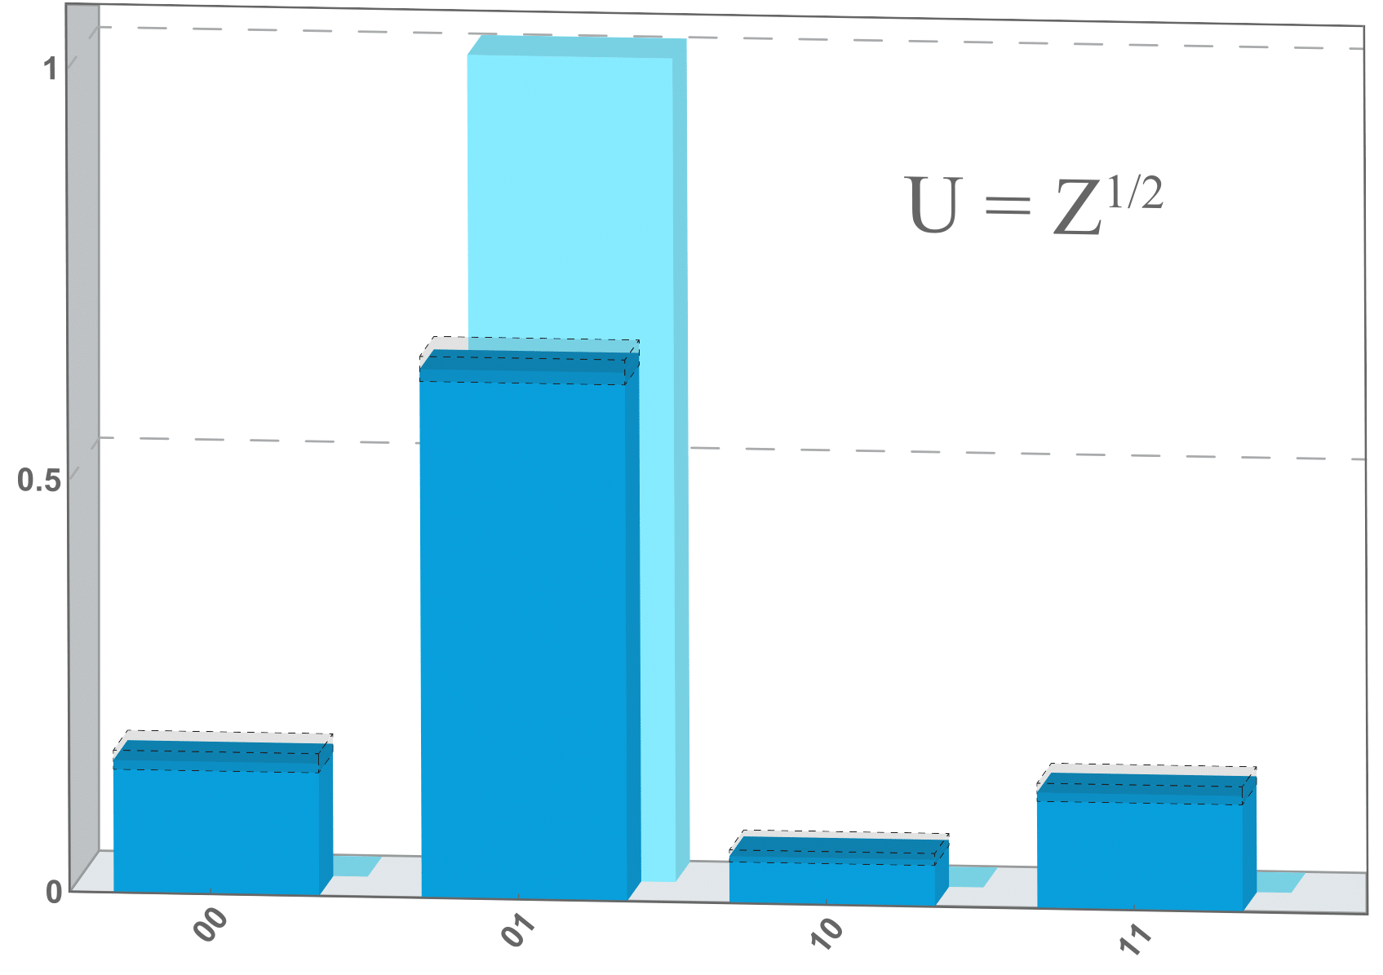
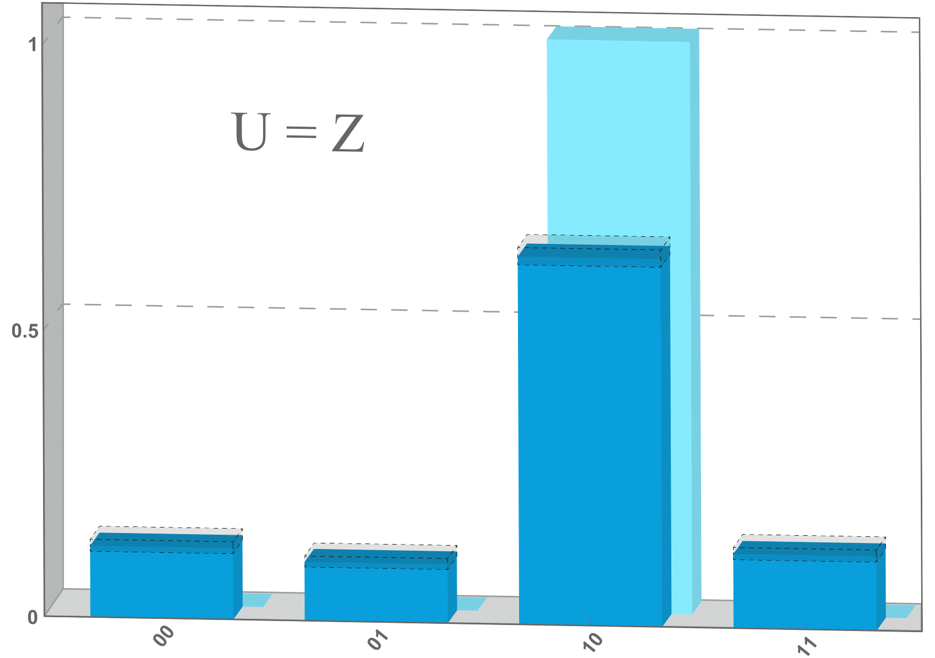
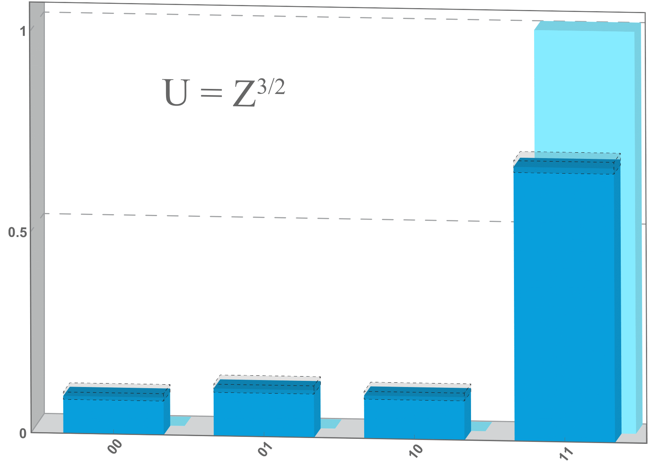
Quantum phase estimation
Quantum phase estimation is one of the most important quantum algorithms. Useful for quantum chemistry and factoring.
Test for measuring phases of 0, π/2, π, 3π/2
Nature 604, 457 (2022)
1
U = I
U = Z^{1/2}
U = Z
U = Z^{3/2}
0.5
0
00
01
10
11
00
01
10
11
00
01
10
11
00
01
10
11

Slide 20
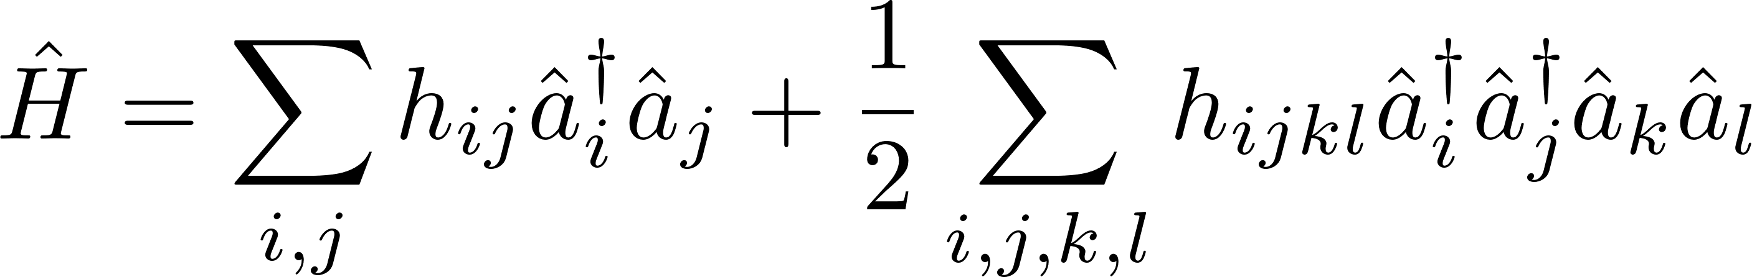
Quantum phase estimation – Hydrogen molecular energy
Hydrogen molecular Hamiltonian
qubit encoding
2-qubit Hamiltonian
P. J. J. O'Malley et al., Phys. Rev. X 6, 031007 (2016)
symmetry
1-qubit Hamiltonian
4 electronic orbitals
S. Bravyi et al., arXiv:1701.08213
Experiment
1st order Trotterization

Slide 21
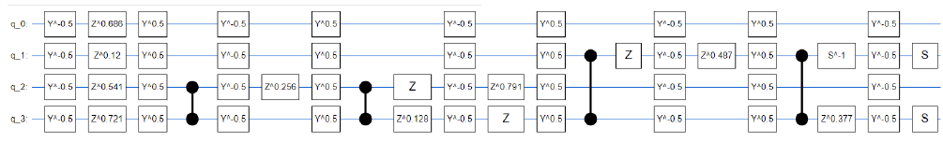
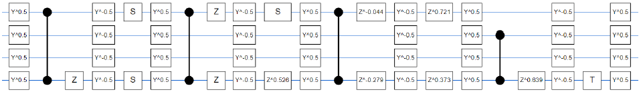
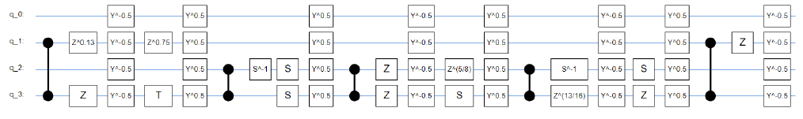

Quantum phase estimation – Hydrogen molecular energy
Hydrogen molecular Hamiltonian
qubit encoding
2-qubit Hamiltonian
P. J. J. O'Malley et al., Phys. Rev. X 6, 031007 (2016)
symmetry
1-qubit Hamiltonian
4 electronic orbitals
S. Bravyi et al., arXiv:1701.08213
Experiment
1.1 ms execution time, circuit depth of 57 1Q gates and 14 2Q gates

Slide 22



Quantum phase estimation – Hydrogen molecular energy
Hydrogen molecular Hamiltonian
qubit encoding
2-qubit Hamiltonian
P. J. J. O'Malley et al., Phys. Rev. X 6, 031007 (2016)
symmetry
1-qubit Hamiltonian
4 electronic orbitals
S. Bravyi et al., arXiv:1701.08213
Experiment
measurement qubits
well-resolved
ground energy
E_{g} = -1.06 Ha
state qubit
Nature 604, 457 (2022)

Slide 23

Quantum Approximate Optimization Algorithm (QAOA)
QAOA can be thought of as a discretized (Trotterized) version of adiabatic evolution.
Farhi & Goldstone (2014)
weights (classical number)
1. Start the system in the ground state of a mixer Hamiltonian.
2. Alternate application of mixer and problem unitaries.
3. Update weights (classical optimizer) of mixer and problem unitraries to arrive at ground state of problem Hamiltonian.
U_{mixer}
U_{problem}
→ hybrid quantum-classical algorithm
Example: MaxCut graph problem. Divide the vertices of a graph into two sets to maximize the number of cuts across the set boundary.
Classically hard – no polynomial time classical algorithm that can find the optimal solution for arbitrary graphs.

Slide 24





QAOA MaxCut – 4 qubits
QAOA for 4 node MaxCut
q0
q3
q2
MaxCut solutions are 0001 and 1110
Noise free prediction for p=1,2,3 is AR=0.77,0.95, ~1.0
q1
6 CZ
12 CZ
18 CZ
Nature 604, 457 (2022)
p=1
AR=0.67
p=2
AR=0.69
p=3
AR=0.63
p=2 improvement

Slide 25
What’s next?
Neutral atom’s capability to implement quantum circuits up to 6 qubits has been demonstrated, although it is very far from quantum advantage yet. Towards better performance,
Two-qubit gate of higher fidelity: better localization & crosstalk
More scalable trap
Non-destructive measurement

Slide 26







Two-qubit gate of higher fidelity: better localization
Localization of trapped atoms
d
I_{c}
I_{s}
I₀
- current condition
temperature: 5 μK
trap frequency: 19 kHz (0.3 mK depth)
Higher fidelity demonstration with deeper and narrower red trap
temperature: 11 μK
trap frequency: 63 kHz (1.1 mK depth)
F(raw) = 95.7%
F(SPAM-corrected) = 98.2%

Slide 27





Two-qubit gate of higher fidelity: better crosstalk
Time-dependent crosstalk by beating between dual-addressed lasers
459 nm
1040 nm
~ MHz
difference
Dual-scanner setup for controlling the beating

Slide 28



New simple & passive trap design for more scalability
“Hole array” blue-detuned trap
35 × 35 =1,225 sites
Experiment with atoms
808 nm 35 W incoherent laser
trap depth: 0.46 mK
trap frequency: 44 kHz
→ about 2 times narrower
P. Huft, Y. Song et al., arXiv:2204.07788
single-shot
averaged
histogram

Slide 29






Non-destructive readout for Cs atoms
Non-destructive readout with deep trap
Cs experiment
1064 nm red tweezer
trap depth: 10 mK
imaging time: 5 ms
detection fidelity = 98 - 99%
survival probability ~ 99%
Shot 1 counts
Rb experiments: M. Kwon et al., PRL (2017)
Shot 0 counts
Cooling with 685 nm quadrupole transition
natural linewidth: 124 kHz, T_{doppler} = 3 μK
with 685
without 685
comparable with Yb ³P₁ transition
closed cycling transition
Could be used for cooling
for non-destructive readout
(even for optical clock)
A. Sharma, S. Kolkowitz, and M. Saffman, arXiv:2203.08708
685 MOT ?!

Slide 30











Team Atomic Qubit Array (AQuA) @ UW-Madison
Professor
Mark Saffman
Scientist
Trent Graham
Postdoc
Yunheung Song
Graduate student
Xiaoyu Jiang
Graduate student
Cody Poole
Graduate student
Jacob Scott
Research assistant
Kais Jooya
Research assistant
Linipun Phuttitarn
Undergraduate student
Patrick Eichler

Slide 31

Summary
The AQuA at UWM has demonstrated first quantum algorithm results with a gate model neutral atom quantum computer.
Currently have high fidelity state preparation, measurement, and 1Q gates.
Moderate fidelity 2Q gates, close to F=0.96, with improvement expected from further progress in laser cooling / optics / system automation.
Neutral atoms are an inherently scalable platform and we anticipate continued advances in the coming year.
Cloud availability in 2022 from ColdQuanta.
July, 2021

